Slide 1
Pet Portfolio Delivery – Executive Delivery Committee
8/24/2026
Cindy Trudeau
Reporting period: Project Status as of 7/31/2026

Slide 2
Delivery momentum is intact; executing remaining 2026 work is key focus area.
July Delivery Accomplishments Since Last Meeting
Key Project Updates
Employer Portal – Bundle 3 (VBO Admin) complete; Bundle 4 (Billing) dev complete with testing in progress; Bundle 5 (Payments & IAM) dev started.
Tailwinds / Pet Claims Flagship – Deployed Fax Ingestion and the Postal Mail Adapter to production enabling automated intake and advanced Email Ingestion.
Policy Migration – 86% of policies in approved states migrated (MM→MPI CA 99.7%, MPP→MPPC 85.6%, WP→MPI 71.2% as of 7/3); Wave 14 (PA) and Wave 15 (MD) in flight.
Payroll Billing Defects – Wave 1 (8 critical defects) deployed to prod; Talend-to-Python core migration stable with phased releases continuing.
Pet Model Law Reboot – Wave 2 states deployed 7/15 (Wave 3 targeted 8/12).
Pet Data Center migration successfully deployed 7/24.
Employer Portal (Yellow): remains yellow on incremental Finance-integration requirements; Bundle 4 testing and Bundle 5 in progress. MVP targeted 10/14 at 7/31, then moved to 11/11 (early Aug) to align with Finance IT delivery.
Tailwinds / Pet Claims Flagship: Fax and Mail intake channels in production; EAO now has Fax and Mail data for experimentation; positive feedback at Executive Steering Committee.
Key Risks
An influx of approved work being released late in the year requires quick action from Tech to create capacity for the incoming demand and ensure budget spend in 2026. Project contingency will be monitored monthly.
Financials as of early August
2026 portfolio contingency is fully directed and executing — $2.4M committed to approved work in early August. No further asks can be funded without a rebalance or reserve release.
Two portfolio reserves are monitored monthly after financial close: (Compliance and Product Rate Refresh / Profitability).
2026 favorability was used to accelerate select 2027 work (Major Medical, MM-to-MM migration, manual migration) to reduce 2027 pressure.
Pet Portfolio Delivery – Executive Delivery Committee | Data as of 7/31/2026

Slide 3
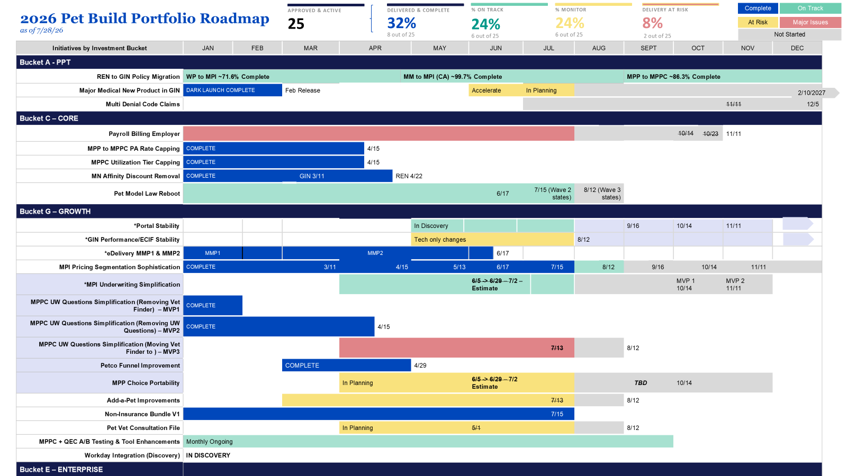

Slide 4
Employer Portal MVP moved to 11/11 to align with Finance IT delivery
As of 7/31/2026
Production deployment for the MVP was targeted for October 14; confidence lowered at 7/31 due to misalignment with the Finance delivery timeline and key dependencies. In early August, the MVP was rebaselined to November 11.
July 10 confidence checkpoint was contingent on ~40% completion of DDIT; IAM and DDIT progress remain key confidence markers.
Bundle 3 (VBO Admin) complete; Bundle 4 (Billing) testing; Bundle 5 (Payments & IAM) dev started; Bundle 6 (IAM Integration + Finance) is the final phase before go-live.
First MVP groups aligned to 1/1 effective date; first invoices expected mid-December (12/18).
Employer onboarding begins in September, then ongoing; Sales confidence checkpoint September 1.
Delivery follows an incremental, cumulative approach across bundles to reduce risk.
Incremental bundle delivery
Bundle 1
Bundle 2
Bundle 3
Bundle 4
Bundle 5
Bundle 6
Employer / employee details
Communication & servicing
VBO Admin
Billing
Payments & IAM
IAM + Finance Integration
Complete
Testing
In dev
Final phase
Pet Portfolio Delivery – Executive Delivery Committee | Data as of 7/31/2026

Slide 5
2026 contingency is fully directed to $0 remaining; 2027 planning is underway
Updated: As of early August
2026 contingency close-out
Reserves monitored monthly (after financial close)
Original 2026 contingency pool: ~$2.4M ($2,502,145, incl. product profitability support)
17 OpX-approved items funded across prior reviews (–$1.27M), leaving $1,230,265 to direct
Newly approved Tech-recommended work of $1,230,265 draws the remaining balance near $0.
  GIN long-term stability (support 1.25–2.0M policies): ($463,000)
  GIN API v.5: ($350,000)
  Employer Portal Post-MVP (multi-pay frequency, termination in UI, Sales AE enrollment reporting): ($250,000)
  PPT Acceleration (NY & Legacy product build): (~$167,265)
Reserve | Amount
Compliance Reserve | $348,358
Product Rate Refresh / profitability | $106,200
Combined reserve to monitor | $454,558
Compliance Reserve started at $448,358; reduced by MA Junk Fee Regulation ($100,000).
2027 planning — four budget buckets
Bucket | Planning value
A · Pet Transformation (PPT) | $4M
C · Core Operations | $8.55M
G · Growth | $5M
E · Enterprise (TailWIND Phase 2) | Emerging as of end of July
Tagged work is moving into estimation for a Q1 2027 DDIT start; OpX roadmaps / sequencing are the input needed to lock the order of work.
Pet Portfolio Delivery – Executive Delivery Committee | Data as of 7/31/2026

